Slide 1



RAVIZ HOTELS & RESORTS
LOYALTY CARD MANAGEMENT PROJECT
We Engineer your
PRESENTED BY PRASHANT THOMAS SOLUTION ARCHITECT
Digital Success

Slide 2


The core objective is to develop a web and mobile application software to frontend the RavizPriviliz line of rewards card. The application shall provide the following key functionalities on a turn key basis
A more personalized experience for Reward card owners
Interactive card based options for front desk operations
Analytics for Management on card use and characteristics
Back office functions for card management & promotions
Our solution incorporates future proofing the application to support
Integration with CRM & ERP applications
Integration with in App map and navigation
Integration for Digital check-ins
Product promotions, campaigns & cross selling
OBJECTIVE
Let’s walk through the process…
Notes:
Objective for this presentation was to give u a solution that is fit for purpose…while at the same time exploring the possibilities of taking this to the next level
Part 1 addresses the reward card owners, along with the card we will provide an application that will provide a more personalized experience
Most often the customer woild take the card to the front desk. So part 2 of the soulution addresses the front desk operators. We will arm them with information about the customer so that they can swiftly respond to the customer. Thus again is an extension of the personal experience we just talked about
Part 3 takes into account all of the interaction the customer has with the hotel. Using analytics we will derive meaning towards these interactions
Part 4 Provides support to the back office so that they can help initiate management decisions.
While these takes care of the basics needs, we propose that you future proof the application to support

Slide 3
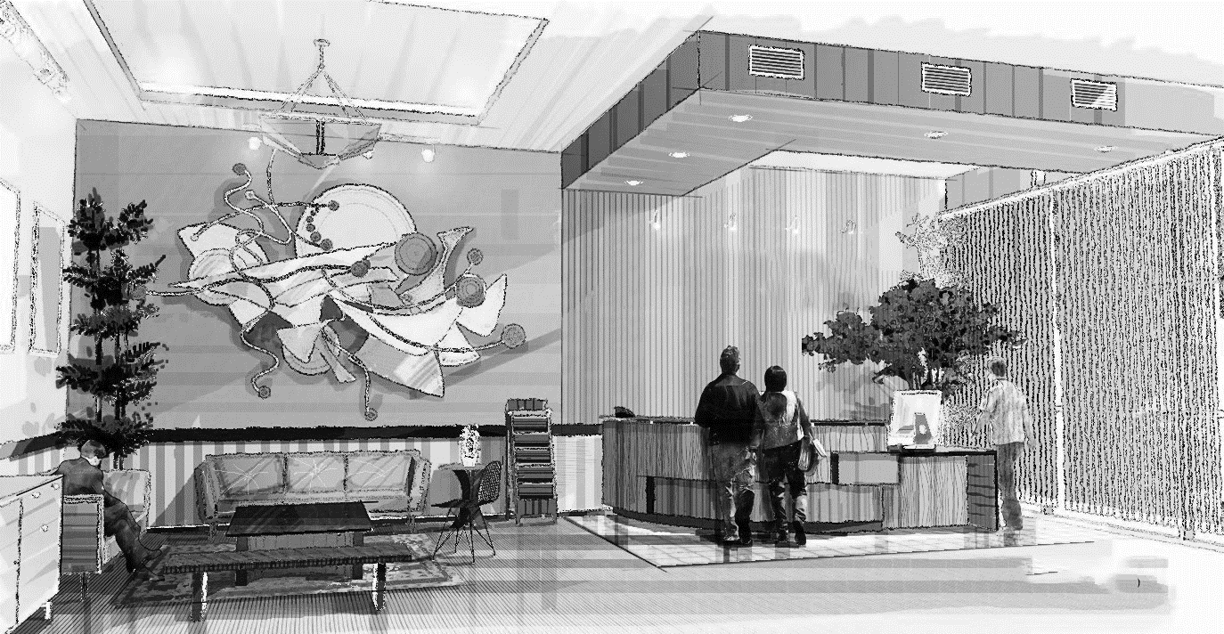
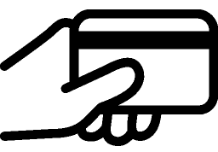


Carry Card on Person
FEATURES OF RAVIZ Current LOYALTY CARD MANAGEMENT System
Verification is manual
Cannot track card use in Real Time
Notes:
Lets explore the status quo, This is how we understand how the system works as of now

Slide 4




Current System’s Pain Points
No Insight into the customer profile
Cannot track rewards
Cannot track point redemptions
Cannot Cross sell or upsell
Notes:
No personal information about the customer, by that I mean their purchase habits, preferences etc..
Neither you nor your customer can keep a track of the points received
Cannot track the rewards that the cutomer can redeem
Cannot cross sell or upsell

Slide 5

SOLUTION OVERVIEW
Dashboard for Customers
Dashboard for FD (Intuitive Front Desk Operations)
Mobile & Web App
Soft Copy of the card
Dashboard for Management (Reports & Analytics)
Dashboard for Back Office Operations
Notes:
Dashboard available for the user both on the web as well the mobile app. Dash provides an overall view of his account, such as points redeemed, rewards available etc
Dashboard for FD provides insight into customers profile and shopping history, frequently used services etc.
Dashboard for the management provides insight into the hotels clientele, campaigns that worked, services and products that are most valued
Back office operations helps to service client requests, create campaigns, coupons etc.

Slide 6




Value Adds
We recommend the following integrations to further enhance your value proposition
 | Integration with CRM or HMS |  | Integration with third party apps like maps
 | Integration for product promotions, campaigns |  | Integration for digital check ins
Notes:
By integrating the loyalty program with your CRM or HMS application, each hotel will get visibility on the full spectrum of interactions that a customer has with the hotel chain. By providing appropriate service end points within each property, we can collect information on customer profiles, spending patterns and provide status recognition for esteemed guests.
Integration with third party apps adds convenience to their fingertips. Now your guests can get directions to the nearest property in a moments notice. Knowing the distance and the direction will fast track the customers decision to check into your property. Incorporation of beacon technology will provide your guests with the ability to navigate to different locations within the property without any guides
By integrating the application with the hotels CRM and with the app being location aware, the customer can now receive individually tailored promotions and campaigns when they are within range of the property or geo-fence. Customers can also take advantage of the hotel concierge services, browsing a menu and ordering food specific to the restaurants within the property
Digital check-ins extend from online bookings of rooms to hotel check-ins using your mobile apps, completely sidestepping the front desk and using the phone app as the room key. This again introduces a new level of convenience by reducing the check-in time for customers, as well as savings from reduced staffing for hotels. Not to mention the savings in key cards, improved guest experience.
Disrupt: catch word

Slide 7
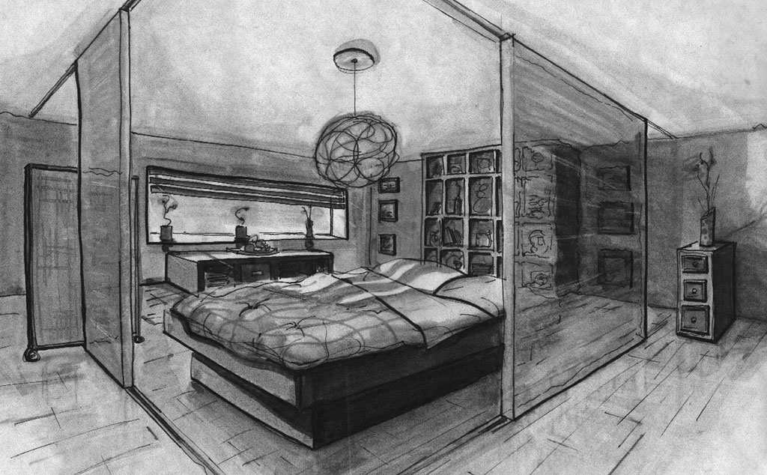





Inception & On Boarding
New Customers or Existing Customers
Create Soft Cards
Card Issuance & Soft Links
Hard Linking on sign on
Prompt to install app if on mobile
Customer Dashboard
Notes:
Inception & Onboarding are different activities. When the management for example realize that the priviliz line of cards are a huge success esp. with the high net worth clients, they may decide to release a new card membership with a different reward structure meant to capitalize on the spending habits of high net worth clients. In order to realize this, at the inception of the new program, cards will have to printed.
On the application side, soft copies of the cards will need to be created. This will be the system of record for every card that is being printed.
When the cards are released to customers, a soft link will be created between the soft copy of the card and the customer record
When customers sign on the web using their account number, a hard link will be created, this will enable the business to establish communication with the client via mail or phone.
If the customer links the account using a mobile device, they will be redirected to the app center to install the app, else they will receive a notification on the mobile phone with a prompt to install the app
After the customer installs the app, he will be able to see his dashboard.

Slide 8
Customer Dashboard
Softcopy of Card
In-App Adverts
Out-App Adverts
Points redeemed and availed offers
Notes:
The customer dash board of the mobile app will have the following features
A reference to the soft copy of the card. This soft copy will essentially be an image of the card with name, card number, expiration date and a barcode on the back if needed
The mobile app will receive in app and out app adverts or notifications. Explain in app and out app notifications
It will also show the points that the customer had already redeemed and the offers that the customer availed using those points

Slide 9
Customer Dashboard
Points available for redemption
Rewards / Offers
Static Info
Complaints / Feed back

Slide 10


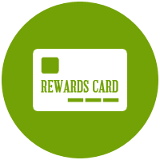



Front Desk
Personalized Offers
Cross Selling / Up Selling
Customer Profile
Issue New, Duplicate Card
Refunds
Member Discounts
Redeem Coupons
Front Desk
Notes:
When the customer arrives at the front desk, the CSR will have access to the customer profile, his purchase history, what card he/she is carrying etc.
This gives them information about the discounts and amenities available for the customer
When necessary the front desk can refund the customer for charges that should not have been expensed on them. Re-imbursements can be made to his loyalty card
Based on the customer profile FD can make personalized offers, cross sell or upsell products or services
FD can also issue new cards/ upgrade cards or issue duplicate cards
Customers can also bring in coupons or vouchers from printed media. These coupons can be scanned to avail offers

Slide 11







Back Office
Customer Management
Create News Letters
Manage Card Profiles
Manage Properties
Manage Coupons
Create Promotions
Back Office
Notes:
Back office is where the administration for the application takes place. Back office can provide services to the customers as well as the management.
For example
They can create coupons that can be distributed to customers via the mobile application. Coupons are available as In-App notifications
They can create new card profiles. Profiles that can be used to create tiered card services that have different sets of rewards and discounts
Back office customer service reps can directly service customers, by updating their profile information or booking details etc.
Back office can also create news letters or other static information that can be distributed via mobile phones
Instances of New properties being added to the chain can also be instantiated by the back office operations
Promotions can be created and customers receive these promotions as out-app notifications

Slide 12






MANAGEMENT DASHBOARD
Track Purchases
Track Rewards Redeemed
Track Coupons
Track Customer Profiles
Assign Point Value
Notes:
Management dashboard is a window that presents aspects and results of the decisions made by management. It helps them to know what worked and what didn’t.
Some examples are
Understand what products or services are being purchased the most
What rewards are being redeemed the most
Get a better understanding of your customer base, their profiles
How are customers availing points, bookings , services, dining etc?
Assign value to points and how to receive points

Slide 13







Concerns Addressed: Customers
Customer Dashboard with soft copy of card & consolidated view of points available & redeemed, Rewards Gained and Rewards Available
Register Customer
Receive in-App and Out-App Advertisements, Receive News letters and Updates
Create system of records for cards issued
Coupons and Discounts
Inception and On-Boarding
Feedback and Complaints

Slide 14






Concerns Addressed: Front Desk - Kiosk
Issue New/Duplicate Card
Customer Feedback & Complaints
Upsell & Cross sell based on Recommendations
Purchase History
Refunds
Member Details
Issue Coupons/Discounts

Slide 15

Back Office
Management
Create/Manage
Parameterized Dashboard view (mobile and Desktop) to
Track purchases (Products or Services), Rewards redemptions, Coupons
Determine Customer profiles
Define Point Value System
Concerns Addressed
Coupons
News Letters
Properties
Manage Customers

Slide 16

[
[
Q A
nd

Slide 17

Thank You
© 2017. All Rights Reserved |Tollant Systems International Pvt. Ltd.

